Slide 1



Introduction to SQL for Data Analytics
I. Introduction to SQL
A. What is SQL?
B. Why SQL is important for Data Analytics?
C. Basic SQL Syntax
D. Setting up your SQL Environment
A. What is SQL?
SQL, short for Structured Query Language, is a robust programming language utilized for the management, manipulation, and querying of relational databases. It serves as the industry-standard language for database interaction and plays a crucial role in data analytics, empowering users to efficiently retrieve, update, and analyze data.
by Busayo Oyewole

Slide 2
B. Why SQL is Important for Data Analytics?
Data Retrieval: SQL allows data analysts to extract specific information from large datasets, making it an essential tool for data retrieval and reporting.
Data Transformation: It enables the transformation and cleaning of data, ensuring that data is in a usable format for analysis.
Data Analysis: SQL provides the foundation for conducting data analysis tasks, such as aggregating, filtering, and joining data from multiple sources.
Data Visualization: SQL queries can be integrated with data visualization tools to create insightful charts and graphs for better decision-making.

Slide 3
Component
Description
SELECT
Used to retrieve data from one or more tables.
FROM
Specifies the table(s) from which data is retrieved.
WHERE
Filters data based on specified conditions.
ORDER BY
Sorts the results in ascending or descending order.
LIMIT
Restricts the number of rows returned.

Slide 4
The Language of Data
Tables
Queries
Constraints
Tables are the core building blocks of a relational database, organizing data into rows and columns.
Queries allow you to retrieve specific data from one or more tables based on specific criteria.
Constraints maintain data integrity by imposing rules on the data, ensuring its accuracy and consistency.

Slide 5
D. Setting up Your SQL Environment
Database Management System (DBMS)
Database Creation
SQL Editor
Create or connect to a database.
Select an SQL editor or interface.
Choose and install a DBMS like MySQL, PostgreSQL, or SQLite.
Connection
Practice Database
Establish a connection to your database.
Set up a practice database with sample data.
By the end of this chapter, you'll have a foundational understanding of SQL.
Example Project:

Slide 6
Example Project:
Create a simple SQL query that retrieves all records from a practice database table.
Apply basic SQL syntax to filter the records to only include those that meet specific criteria.
Sort the results based on a chosen column.
Limit the number of rows returned to a specified number.
This project will help students practice the concepts introduced in this chapter and gain hands-on experience with SQL syntax and querying.

Slide 7


Chapter II: Retrieving Data
A. SELECT Statement
The SELECT statement is the fundamental SQL command used to retrieve data from a database.
Retrieving All Columns
To retrieve all columns from a table, use the asterisk (*) wildcard character.
Example
SELECT * FROM customers;
Project: Retrieve all information from a customer database and generate a basic report.
2. Retrieving Specific Columns
Specify the columns you want to retrieve by listing their names.
Example:
sql
SELECT first_name, last_name, email FROM employees;
Project: Select specific columns from a product inventory table to analyze product details.
3. Using Aliases
Aliases allow you to rename columns or provide more meaningful labels.
Example:
sql
SELECT product_name AS "Product Name", unit_price AS "Price" FROM products;
Project: Apply aliases to make the output of your query more user-friendly.
B. Filtering Data with WHERE Clause
The WHERE clause is used to filter rows based on specified conditions.
Example:
sql
SELECT * FROM orders WHERE order_date >= '2023-01-01';
Project: Filter orders based on specific date ranges or other criteria in a sales dataset.
C. Sorting Data with ORDER BY
The ORDER BY clause is used to sort the results in ascending or descending order.
Example:
sql
SELECT product_name, unit_price FROM products ORDER BY unit_price DESC;
Project: Sort and display data in various ways to understand how sorting affects data presentation.
D. Limiting Results with LIMIT
The LIMIT clause is used to restrict the number of rows returned by a query.
Example:
sql
SELECT * FROM employees LIMIT 10;
Project: Practice limiting the number of results to view a subset of data for analysis.
By the end of this chapter, students will have a solid grasp of how to retrieve data from a database using SQL, including selecting specific columns, applying aliases, filtering data, sorting results, and limiting the number of rows returned. These skills are essential for data analysis and reporting.
Example Project:
Using a provided dataset, write SQL queries that retrieve specific columns, apply filtering conditions, sort the results in different ways, and limit the number of rows returned.
Create a report summarizing the findings and insights gained from the retrieved data, emphasizing the importance of each SQL concept introduced in this chapter.

Slide 8
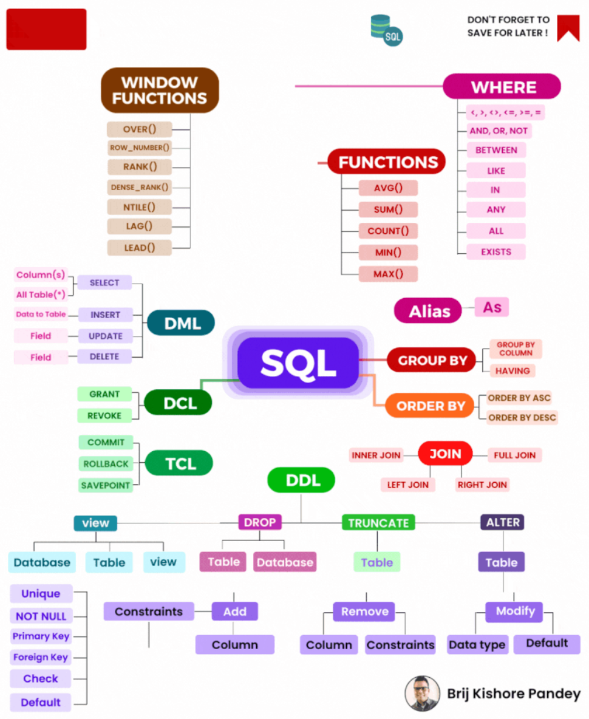

Slide 9

Chapter III: Filtering and Conditional Operations
A. Comparison Operators (e.g., =, <>, <, >, <=, >=)
Comparison operators are used to compare values in SQL and are essential for filtering data based on specific conditions.
Examples:
sql
SELECT product_name, unit_price FROM products WHERE unit_price > 50; SELECT customer_name FROM customers WHERE customer_age <= 30;
B. Logical Operators (e.g., AND, OR, NOT)
Logical operators allow you to combine multiple conditions to create more complex filters.
Examples:
sql
SELECT product_name, unit_price FROM products WHERE category = 'Electronics' AND stock_quantity > 10; SELECT employee_name FROM employees WHERE NOT department = 'HR';
C. BETWEEN and IN Operators
The BETWEEN operator checks if a value is within a specified range, while the IN operator is used to match values against a list.
Examples:
sql
SELECT order_date, total_amount FROM orders WHERE order_date BETWEEN '2023-01-01' AND '2023-12-31'; SELECT product_name FROM products WHERE category IN ('Electronics', 'Clothing', 'Appliances');
D. NULL Values
NULL represents missing or unknown data in SQL. Understanding how to handle NULL values is crucial when filtering data.
Examples:
sql
SELECT customer_name, email FROM customers WHERE email IS NULL; SELECT employee_name, manager_name FROM employees WHERE manager_name IS NOT NULL;
Example Project: Analyze Sales Data with Filtering and Conditional Operations
Project Objective: Analyze a real-world sales dataset to gain insights and identify specific sales transactions that meet certain criteria.
Project Tasks:
Data Exploration: Get familiar with the sales dataset, including the available columns and their data types.
Basic Filtering: Write SQL queries to filter sales data based on simple conditions, such as sales in a specific date range or those above a certain amount.
Complex Filtering: Apply logical operators to filter data based on more complex conditions, like finding sales in a particular product category with quantities greater than a certain threshold.
Range and List Filtering: Use the BETWEEN and IN operators to identify sales within specific price ranges or those associated with particular payment methods.
Handling NULL Values: Investigate and address any NULL values in the dataset, such as missing customer information or unassigned sales representatives.
Insightful Analysis: Summarize your findings, highlighting the importance of filtering and conditional operations in uncovering meaningful insights from the data.

Slide 10
Chapter IV: Aggregating Data
1
A. Aggregate Functions
2
B. GROUP BY Clause
3
C. HAVING Clause
Group rows with a common value into summary rows.
Filter results of aggregate functions after the GROUP BY clause.
Perform calculations on groups of rows.
Examples:
Examples:
Examples:
SELECT COUNT(*) AS total_orders FROM orders; SELECT AVG(unit_price) AS avg_price FROM products;
SELECT category, AVG(unit_price) AS avg_price FROM products GROUP BY category; SELECT year(order_date) AS order_year, COUNT(*) AS total_orders FROM orders GROUP BY order_year;
SELECT category, AVG(unit_price) AS avg_price FROM products GROUP BY category HAVING AVG(unit_price) > 50; SELECT salesperson_id, COUNT(*) AS total_sales FROM sales GROUP BY salesperson_id HAVING COUNT(*) > 100;
Example Project: Analyze Sales Data with Aggregation
Project Objective: Calculate various statistics from a sales dataset, grouped by different categories.
Data Preparation: Load and examine the sales dataset.
Total Sales: Calculate the total sales revenue.
Average Order Value: Determine the average order value.
Sales by Product Category: Group sales data by category and calculate total sales for each category.
Sales by Region: Group sales data by region and calculate total sales for each region.
Monthly Sales Trends: Group sales data by month and year, calculating total sales for each period.
Identify Top Performers: Use aggregate functions to identify top-performing salespersons.
Apply Filters: Utilize the HAVING clause to filter results.
Insightful Analysis: Summarize findings and present actionable insights.
By completing this project, students gain practical experience in using SQL to aggregate and analyze data.

Slide 11
Chapter VI: Subqueries and Derived Tables
1
A. Subquery Basics
2
B. Correlated Subqueries
3
C. Derived Tables (CTEs)
Subqueries are SQL queries embedded within other queries.
Correlated subqueries reference values from the outer query.
Derived tables are temporary result sets that can be referenced within a query.
Example:
SELECT product_name FROM products WHERE product_id IN (SELECT product_id FROM order_details WHERE quantity > 10);
Example:
SELECT customer_name FROM customers c WHERE EXISTS ( SELECT 1 FROM orders o WHERE o.customer_id = c.customer_id AND o.order_date >= '2023-01-01' );
Example:
WITH high_value_orders AS ( SELECT order_id, total_amount FROM orders WHERE total_amount > 1000 ) SELECT o.order_id, o.order_date, h.total_amount FROM high_value_orders h JOIN orders o ON h.order_id = o.order_id;
Example Project: Identifying Trends with Subqueries
Project Objective: Use subqueries to identify patterns and trends in data.
Data Exploration: Examine the dataset(s) and identify potential trends or patterns.
Basic Subqueries: Retrieve specific data points or aggregate information for further analysis.
Correlated Subqueries: Create subqueries that reference data from the outer query.
Derived Tables (CTEs): Use CTEs to structure and simplify queries.
Identify Trends: Investigate trends in data, such as customer behavior, product popularity, or seasonal variations.
Data Visualization: Create visualizations or summary reports to present the identified trends.
Insightful Analysis: Summarize findings, emphasizing how subqueries and derived tables contributed to uncovering insights.

Slide 12




Chapter VII: Data Modification
1
A. INSERT INTO
2
B. UPDATE
3
C. DELETE
The INSERT INTO statement is used to add new records into a database table.
The UPDATE statement allows you to modify existing records in a database table.
The DELETE statement is used to remove records from a database table.
Example:
Example:
Example:
DELETE FROM customers WHERE customer_id = 501;
INSERT INTO employees (employee_id, first_name, last_name, hire_date) VALUES (101, 'John', 'Doe', '2023-02-15');
UPDATE products SET unit_price = 49.99 WHERE product_id = 101;
Example Project: Data Modification and Integrity
Project Objective: Modify a database by inserting new records, updating existing records, and deleting unwanted data while ensuring data integrity.
1
Project Tasks:
Data Review: Examine the dataset and identify areas where data modification is needed, such as adding new employees, updating outdated information, and removing redundant records.
INSERT INTO: Write SQL queries to add new records to the appropriate tables, ensuring that primary key constraints and data integrity rules are upheld.
UPDATE: Modify existing records by updating information like employee details or product prices, considering any constraints or validation rules in place.
DELETE: Safely delete unwanted records, such as outdated customer information or discontinued products, while avoiding data corruption.
Data Validation: Verify that the modifications have been successfully applied and that data integrity remains intact.
Documentation: Document the changes made, including the reasons for each modification and any related constraints or validation rules.
Test Scenarios: Create and execute test scenarios to ensure that data modifications did not introduce errors or violate data integrity constraints.
Final Data Integrity Check: Recheck data integrity after modifications to confirm that the database remains consistent and accurate.
By completing this project, students will gain hands-on experience in data modification operations (INSERT INTO, UPDATE, DELETE) and learn how to maintain data integrity while making changes to a database, a crucial skill for data analysts responsible for managing and updating databases in real-world scenarios.

Slide 13
Chapter VIII: Indexing and Performance Optimization
1
A. Understanding Indexes
2
B. Query Optimization Techniques
3
C. Analyzing Query Execution Plans
Indexes improve data retrieval speed by providing faster access to rows in a table.
Query execution plans offer insight into how the database engine processes queries.
Optimize SQL queries for better performance:
Use of Indexes: Create and utilize indexes for faster data retrieval.
Optimal Joins: Choose efficient join types based on query requirements.
Limiting Result Sets: Reduce rows returned using the LIMIT clause.
Proper Data Types: Select appropriate data types for columns to improve speed.
Avoiding Wildcards: Minimize the use of wildcard characters in search patterns.
Example Project: Query Optimization
Project Objective: Optimize a slow-performing SQL query using indexing and performance tuning techniques.
1
Project Tasks:
Identify Slow Query: Choose a slow-performing SQL query.
Index Analysis: Identify potential columns for indexing.
Index Creation: Create indexes on selected columns.
Query Refactoring: Review and optimize the query's structure and logic.
Query Execution Plan: Analyze the query execution plan.
Performance Testing: Measure performance improvements.
Documentation: Document optimization steps and their impact.
Final Analysis: Summarize results and provide recommendations.

Slide 14
Project Tasks:
Identify Slow Query: Choose a slow-performing SQL query that retrieves a significant amount of data or takes too long to execute.
Index Analysis: Examine the tables involved in the query to identify potential columns for indexing. Consider which columns are frequently used in WHERE clauses or JOIN conditions.
Index Creation: Create indexes on the selected columns to speed up data retrieval.
sql
-- Example: Creating an index on a 'customer_id' column CREATE INDEX idx_customer_id ON orders (customer_id);
Query Refactoring: Review the query's structure and logic. Determine if there are any opportunities to optimize the query itself, such as simplifying joins or reducing the number of columns retrieved.
Query Execution Plan: Generate and analyze the query execution plan to understand how the database engine processes the query.
sql
EXPLAIN SELECT * FROM orders WHERE order_date >= '2023-01-01';
Performance Testing: Execute the query before and after optimization to measure performance improvements.
Documentation: Document the optimization steps taken and their impact on query performance.
Final Analysis: Summarize the results and provide recommendations for future query optimization efforts.

Slide 15
IX. Advanced SQL Topics (Optional)
1
A. Window Functions
2
B. Common Table Expressions (CTEs)
3
C. Stored Procedures and Functions
Perform advanced calculations on rows within a specified window.
Create temporary result sets that can be referenced within a query.
Write reusable code blocks to perform specific tasks or calculations.
Example Project: Use advanced SQL features to analyze data in more complex ways. For example, calculate moving averages using window functions or create custom functions to process data.

Slide 16
Chapter X: Final Project
A. Apply SQL Skills to a Comprehensive Data Analytics Project
The final project serves as a culmination of the SQL skills and knowledge acquired throughout the course. It provides an opportunity to tackle a real-world data analytics challenge using SQL.
B. Retrieve, Clean, and Analyze a Real-World Dataset
Select a Dataset: Choose a real-world dataset that aligns with your interests or career goals. Datasets can be sourced from various reputable platforms, including:
Kaggle: Kaggle offers a wide range of datasets on various topics.
Government Open Data Portals: Many governments provide datasets related to demographics, economics, and more.
Data.gov: The U.S. government's data repository with a diverse collection of datasets.
UCI Machine Learning Repository: Offers datasets suitable for various data analytics projects.
Data Retrieval: Extract the dataset using SQL commands or import it into your preferred database system.
Data Cleaning: Perform data cleaning tasks such as handling missing values, data type conversions, and removing duplicates.
C. Create Visualizations and Insights from the Data
Data Exploration: Use SQL queries to explore the dataset's structure, identifying key variables and patterns.
Data Visualization: Create visualizations (e.g., charts, graphs) to represent your findings effectively. Tools like Python (using libraries like Matplotlib, Seaborn, or Plotly) or SQL-based visualization tools can be utilized for this purpose.
Data Analysis: Apply SQL queries to perform in-depth data analysis, uncovering insights and trends within the dataset.
D. Present Findings and Actionable Recommendations
Project Report: Compile your findings, visualizations, and analysis into a comprehensive project report. Include an introduction, methodology, results, and discussion sections.
Presentation: Prepare a presentation summarizing the key findings, insights, and actionable recommendations. This can be delivered to an audience or recorded as a video presentation.
Actionable Recommendations: Based on your analysis, provide actionable recommendations or insights that can drive decision-making or inform strategies in the dataset's domain.
Data Sources:
Kaggle: Kaggle (https://www.kaggle.com/datasets) offers a vast collection of datasets on various topics, including finance, healthcare, sports, and more. Many datasets come with detailed descriptions and are ideal for data analytics projects.
Data.gov: If you're interested in government-related datasets, Data.gov (https://www.data.gov/) is a valuable resource, providing datasets from various U.S. government agencies.
UCI Machine Learning Repository: The UCI Machine Learning Repository (https://archive.ics.uci.edu/ml/index.php) offers datasets suitable for machine learning and data analytics projects. It covers a wide range of domains.
GitHub: GitHub (https://github.com/) hosts numerous public repositories that contain datasets shared by individuals, organizations, and research projects.
APIs: Some projects may require data from online APIs (e.g., Twitter, Google Maps, or financial APIs). Accessing data through APIs can provide real-time or up-to-date information for analysis.

